Slide 1
Participatory mid-term assessment of the Land for Life initiative
Burkina Faso

Slide 2
Content 1. Key insights and recommendations / options 2. Methodology 3. Maturity of the MAP 4. Outcomes registered 5. Performance Check
Burkina Faso

Slide 3
1. Key insights and recommendations / options
Burkina Faso
Supported through Land for Life by Welthungerhilfe and the German Ministry for Economic Collaboration and Development (BMZ).

Slide 4
Key Insights
1. Structure and Mandate of LfL 1.1. The transition of LfL in Burkina Faso towards a strong and structured MAP Since the launch of the process in 2019, the LfL and its two support staff (considered or acting as the Secretariat) has been hosted by CPF, with the second phase signed for the period 01/09/2020 to 31/12/2023. In the meantime i.e. on 31 Dec 2021, the government of Burkina Faso issued the Certificate of recognition of the existence of an association N. N000001248101 to an organisation called Plateforme Nationale Multi-acteurs sur le foncier. The PMAF with this act became officially a legal autonomous entity. 1.2. The institutionalization of the MAP/PMAF In December, after a long process and several round of discussions, the LfL formally registered the Plateforme Multi-Acteurs sur le pastoralisme et le foncier (PMAF) as an “Association”, governed by the Burkinabe law N 064-2015/CNT of 20 October 2015 on the freedom of association. To date the platform is composed of XXXXX organizations, including government institutions such as the ministry of territorial administration, the ministry of women affairs; and private sector. Following the institutionalization, a board has been designated. With CPF at the chairmanship. The organic text categorizes the members between “founding members”, “adherent members”, “ex-officio members” (for governmental structures). It is important to understand the rights and obligations of each of these categories of members. For instance, ex-officio members are exempted from membership fees but they seem to have the same rights than other categories of members. Also, it would be important to understand what is the key difference between founding and adherent members apart from the fact that the founding ones participated in the first constitutive General Assembly. Also in the constitution, it is stated that members have to pay membership fees. Would be important to have more details and clarify the procedures. The issue with the dialogue platform is more and more perceived as a competitor of its members and CPF actually requested the Secretariat staff to leave its premises and settle on its own (not sure whether this was not in violation of the partnership agreement). Since the PMAF has not adopted yet its regulatory texts, there is no clarity on how the PMAF will function with what resources. Also, some interlocutors think the legalized MAP is another bureaucratic, procedural and heavy institution, same as members themselves, while they needed a very agile and flexible space. 1.3. The decentralization of the platform / LfL In January 2021, CPF signed a Cooperation Agreement (around EUR 10k) with Union Nationale des Sociétés Coopératives des Producteurs de Coton du Burkina (UNPCB) to organize a serie of activities in the Hauts-Bassins, including the organization of a workshop, capacity building, training of paralegals, etc. Not sure at this stage, we can consider there is a decentralized platform (how is it composed?) and whether it can function without the resources provided by the 2021 agreement.

Slide 5
Key Insights
2. Outcomes & Strategy The LfL/PMAF outcomes in BFA can be organized between their attribution (what was achieved specifically by them) and their contribution (what they contributed to achieve together with others). CONTRIBUTION LfL/PMAF contributed to two main changes 2.1. Implementation of the Law 034-2009 Article 111 of the Law 034-2009 provides that there should be a review of the law every 5 years and in 2020, the BFA government launched the review process. The LfL/PMAF participated in this process by organizing a series on consultations, conducting field visits and preparing a “Contribution note” that was handled to the authorities. 2.2. Improvement of the accountability in the land sector Sharing information and data is key to improve land governance in a country. This is particularly important in a context where the actors work in silos, there is socio-political and security turmoil and lack of confidence between the stakeholders (government, CSOs, FTP, territorial collectivities, private sector, communities and community representatives, etc.). Coupled with a high level of illiteracy when it comes to land legislation. The dialogue platform has managed to facilitate/foster accountability and information sharing through the JNAF (national land action days), different training and capacity building sessions/events. The media were also capacitated and used to disseminate and sensitize the communities and other interested stakeholders. ATTRIBUTION 2.3. Fostering dialogue through the platform Over the past 2 years, the LfL has struggled to establish a multi-stakeholder dialogue platform in the country. Indeed, due to the inactivity of the government National Council to secure land in the rural area (CNSFMR), there was a strong need to create a safe space that brings actors together to discuss land issues. LfL facilitated the set up of this space that is progressively getting visibility. The dialogue platform therefore started to reinforcing its governance organs (board), expanding and decentralizing at the regional level while promoting gender and external communication. A lot of emphasis was also put in building the capacities of the platform members in specific areas of concern such as the multi-stakeholder approach (though in practice this has not been applied), women access to land, as well as the land laws to ensure the dialogue platform members have a common understanding and facilitate policy dialogue and advocacy.

Slide 6
Key Insights
2. Outcomes & Strategy … continued 2.4. Favorable context: The outcomes benefited from some contextual trends. If the military Coup that happened in the country at the beginning of 2022 can be considered as one of the key event with major impact, the same opens the way to new structural changes, including in the land governance sector. Even the coup, the socio-political crisis had been favorable to undertaking some structural reforms. In 2020, and in accordance with the Law 034-2009 in its Article 111, a review of the implementation was initiated by the overthrown government. The process was meant to be very participative and therefore, the LfL/PMAF activated its internal resources and members to get hold of the review team and send them its contribution through the Ministry of Agriculture. The draft evaluation report contains some of the findings/recommendations of the dialogue platform (such as XXXXXX). Another contextual element is the validation and launching of the WB funded project (PAGFM) that includes a land governance component. The project intending to review the existing land legislation, several round of consultation took (including the one organized after the JNAF in December 2021) to see how best civil society can be part of the process. This offered the opportunity to the dialogue platform members to make direct inputs during the design phase of the project through a Memorandum submitted to the WV and the government on 13 September 2019 . The CSO position is to implement the existing provisions rather that completely revising the legislation. It is important to indicate that, even though facilitated by the CPF with the LfL funding, this outcome cannot be attributed to the LfL/PMAF as dialogue platform since organizations signed the memorandum on individual basis, namely L’Association des Femmes juristes du Burkina Faso (AFJ BF), la Confédération Paysanne du Faso (CPF), l’Observatoire National du Foncier du Burkina Faso (ONF BF), le Groupe de Recherche et d’Action sur le foncier (GRAF), TENFOREST and Welthungerhilfe. 2.5. The strategy cycle 2019-2021: in 2019, the LfL/PMAF developed a strategy document for the triennium 2019-2021 with the vision of "A Burkina where good land governance is ensured and people enjoy their land rights without discrimination". The overall objective of the strategy was to “contribute to the realization of the right to food by securing the land rights of smallholder farmers”. Specific objectives included (1) Set up and make operational the multi-stakeholder platform at the national level; (2) Influence the accountability of public action in terms of rural land in Burkina; and (3) Advocate for an acceleration of the effective implementation of Law 034-2009 throughout the national territory. Expected outcomes include (i) Law 034 -2009 is implemented/land tenure security for small farmers is improved; (ii) Improved women's right of access to land; (iii) Improved accountability of public action in terms of land (iv) Improved transparency and accountability in decision-making regarding land and agricultural investments. The outcomes harvesting has focused on the above. During the international workshop of March 2022 in Liberia, a TOC has been developed and further iterated later on. ILC is also funding the development of the next strategy cycle 2021-2024 (or beyond). Resources to do so have been passed to GRAF, and one of the activity is the collection of a set of data to finalize a country baseline through the country Land Governance Index (LANDex). A consultant has already been hired to deliver both assignments by the end of July 2022.

Slide 7
Key Insights
2. Outcomes & Strategy … continued 2.6. Some success factors so far: Strong communication, visibility and media presence: the PMAF secretariat has developed several communication materials including videos (14), leaflets, t-shirts, flyers, newsletters, etc. The dialogue platform is also active on social media through a Facebook account. Along the years, the communication officer has developed close relationship with national media, mainly 10 newspaper, online press, TV channel and radio and hence all the major activities of the platform like the JNAF or the recently held VGGT+10 National Dialogue were well covered. From April 2018 to December 2021 there were 14 media coverages. More and more the PMAF is getting visibility and its own visual identity (i.e. the platform has its own logo). This is the outcome of the communication strategy developed in 2019. Good mobilization capacity: the platform proves to be a reliable space of dialogue that gathers the most important land stakeholders in the country. During the JNAF on 29 and 30 November 2021, more than 100 representatives from governmental institutions, local authorities, civil society, NGOs, international organizations, TFPs, customary, traditional and religious authorities, the private sector, local communities, as well as resource persons (expert, researchers). The event was organized in partnership with the Ministry of Agriculture,, WHH, land for Life, CPF, GRAF, ONF-BF, GIZ, FAO, ILC, Afdi and UFLA. Optimized Field visits: to have a better understanding of the issues on the ground, the dialogue platform successfully organized few field visits. The one organized in June 2021 in Bitou particularly impressed the participants as issues related to pastoralism were discussed with local communities, as well as the PMAF functioning regulatory framework. The previous year i.e. in June 2020, the field visit in Saaba, Boudry et Sapouy allowed to collect inputs from communities on the issues with the Law 034 that fed the Contribution Note. Platform strengthening and decentralization: to get closer to the local communities, the dialogue platform has opted for a decentralized approach. In this regards, the Cooperation Agreement signed in January 2021 between the host CPF and Union Nationale des Sociétés Coopératives des Producteurs de Coton du Burkina (UNPCB) contributes to achieving this objective. The dialogue platform also adopted an expansion policy (though there is no clear guideline on the matter) to attract new and/or relevant stakeholders. This quantitative expansion is back-stopped by capacity strengthening on mainly the platform approach and the land legislation to build common understanding and vision.

Slide 8
Key Insights
3. Performance, and work processes 3.1. The Secretariat The LfL Secretariat is composed of the Coordinator and the Communication Officer. The respondents in their large majority recognize the tenacity and perseverance and both staff members to move forward with the implementation of the planned activities. Despite the various oppositions and misunderstanding the Coordinator is trying to bring together the land actors and reconcile their differences in a common vision. However, some consider that his longevity (lack of) in the land sector is potentially a hindrance to playing the role of convener of actors who have been active in the sector much longer. This means for instance that facilitating compromises between major players on specific issues is sometime more tedious, same as the capacity of keeping some actors in the dynamic. On the communication side, there is definitely some notable vibrancy with a high productivity in terms of outputs. The major issue is the limited dissemination and the inclusion. For the dissemination, all the products (see previous slide) are not necessarily known and availed to the platform members. The existing platforms are not optimally used to communicate or share contents. For instance, only few members subscribed to the Facebook page. Platform members complained also about their limited involvement in the development of these products. For instance, the newsletter is a compilation of the communication officer’s articles, and many of them have never been published. 3.2. The Governance Organs According to the organic text adopted in Sept 2021, the PMAF’s organs include the platform General Assembly and the Board. Since the legal recognition in December 2021, the General Assembly has not met but the Board (formerly the Orientation committee) met several times. Board meetings are particularly appreciated for the quality of the discussions and their engagement. Some of their meetings take place outside of Ouagadougou or during field visits to facilitate focus and increase likelihood of the results. Few potential issues with the board: (i) The decision of making de facto the Board President of the CPF the Board President of the Platform appears to be problematic, since there used to be an annual rotational chairmanship. (ii) The law indicates that each board mandate should not exceed 3 years and cannot even be renewed. During the constitutive General Assembly of September 2021, it was decided that 13 organizations should be statutory board members. It’s not clear how the rotation would be handled; (iii) Duplication of functions: the board is composed mainly of different functions that overlap with the Secretariat functions. For instance, there is a Treasurer in the Board, a Secretary General and a Secretary in charge of information. Not clear how the work of the LfL Secretariat is done under such arrangement and what would be the impact the impact.

Slide 9
Key Insights
3. Performance, and work processes (cnt) 3.3. The implementation arrangements: a questionable platform model CPF has contractual competences not only on financial reporting but also on activities’ reporting, at a monthly frequency. This is very important to stress since CPF indicates that it has signed an agreement to support the implementation of a project (LfL) and NOT to host a platform’s secretariat. No where in the Partnership Agreement between WHH and CPF, the latter is requested to facilitate the functioning of the dialogue platform. In consequence, it is not easy to directly involve other platform members in key steps or decisions, as a principle of inclusion, mutual accountability and joint planning. 3.4. Slow implementation of the action plan. The flow of fund seems to be one of the main reason of the delay in the timely implementation of the activities. The management issue mentioned above with CPF at the core of all the processes has also contributed to the delay observed in some planned actions. 4. Funding 4.1. Funding / sustainability: Beyond WHH/LfL, the PMAF is also benefitting the financial support of ILC that granted USD 50.000 as co-funding of some platform activities, including the JNAF. This funding also supports the development of the new platform strategy as well as the conduct of a land governance baseline through the LANDex. However, the institutionalization of the platform has some financial implications (office running and additional support staff) that are solely covered now by a LfL budget revision. There is also potentially an issue on how the ongoing contractual arrangement with CPF will be handled. Hence a strong need to develop resource mobilization to sustain the functioning of the new entity, without competing with the member organizations. 4.2. The connectivity to the main donor “Welthungerhilfe”: both the country office and the international facilitation team are supporting the PMAF work. However, the change within the country team (both the country director and the LfL program officer) had some negative impact on the process in terms of buy-in. Also the relationship appears to be more and more coercive/restrictive. The Secretariat for instance complains about the fact that the car that has been purchased to facilitate initially to support the initiative has been “confiscated” by the country office and the PMAF secretariat access to it has been restricted/complicated. Also, the LfL project officer is now working only part-time so does not dedicate a lot of attention to the process anymore. For instance, during the MTA, he did not participated at all due to other commitments, which is an issue since this is the program he is responsible for and should be around to improve the delivery and achievements.

Slide 10
Recommendations / Options
1. Structure and Mandate of LfL: The institutionalization of the PMAF was an important step towards the establishment, recognition and credibility of the platform. This was meant to allow more flexibility/agility and clarify roles and responsibilities. Unfortunately in practice, this is not necessarily the case, hence the following recommendations: Clarify issues pertaining to board composition to align with the national legislation, while ensuring there is no duplication of functions between the PMAF Secretariat and the Board Finalize the organic texts of the platform (constitution and rules of procedures) to be used by the General Assembly and the Board, along with the organization’s manual of procedure (HR, financial and admin manuals). The latter would help to ground the institution while the former would strengthen the dialogue platform as common space of interaction between stakeholders of different nature Clarify the transition modalities in relation to the current hosting or contractual arrangements between WHH and CPF, and also between the PMAF Secretariat and CPF. This entails developing a transitional plan with calendar and clear milestone. It should be known to all involved parties when the new institution will really stand alone and function as an autonomous entity. The platform is at the same time expanding and decentralizing. It is important to ensure both processes actually serve the interests of the platform and do not complexify the functioning and the fragile cohesion. 2. Strategy: The PMAF is already developing a new strategy and benefits of the financial support of ILC to do so. In order to fast-track the process and ensure this opportunity is used at its best, it is advised to: Discuss with GRAF, the ILC contractual grantee on how to use the resources: a consultant has been hired to conduct the baseline study through the ILC Land governance Index, and draft the country strategy. About the baseline, the PMAF Secretariat should ensure they are part of the data validation and findings. The Secretariat should also be part of all the discussions between the consultant and GRAF. The draft ToC already developed should be shared with the consultant to ensure that this is taken into consideration. There is a unique opportunity for the PMAF to align the strategy development with ILC model. The strategy and action plan outlines are under development by ILC teams and will be shared with their supported platforms soon. Same as Liberia, BFA will received the said outlines. The new strategy, approved by members during a general assembly or the board, should include the implementation arrangements to ensure ownership and mutual accountability. This means join planning and implementation. Reporting and accountability lines should also be clarified.

Slide 11
Recommendations / Options
3. Funding / Financial sustainability: as already indicated, the PMAF is already benefiting of the financial support of WHH and ILC. To ensure sustainability, it would be important to: Develop a robust resource mobilization or fundraising strategy. This would also include a mapping of the existing potential donors in the country and at the international level, organizing visits to these donors, participating in calls for proposals under consortiums of member organizations. Ensure there is no competition for funds between the dialogue platform members and the institutionalized PMAF. This would mean to the extent possible not interfering with organizations’ usual funders, and also coordinating their fundraising efforts. Understand/map out the platform internal resources: members organizations can contribute in a way or another to the life of the dialogue platform. To this end, the platform should be an added value of their ongoing work. Common vision coupled with complementary actions can easily lead to a better mutualisation of resources. A multi-donor budget with members’ contribution could help. 4. Policy engagement: the PMAF has been very active since its creation in the policy dialogue, with multiform contributions. This engagement should be kept up and even reinforced. Hence, Members should be equipped to engage and invest different arenas where policy issues are discussed. The World Bank project is a window for the review of the existing legislation and the platform should remain vigilant in the direction this review could take, and stand ready to give its inputs in a coordinated manner. The platform should develop an engagement policy that indicates what is their approach and vision. 5. Strengthen visibility: The communication officer is already putting a lot of efforts to create the platform’s identity and ensure its presence in the media. This has led to notable successes and in order to gain more results, it would be necessary to: Pro-actively involve members in the develop of the communication products to ensure their buy-in Update the communication and visibility strategy to ensure all the gaps and shortfalls identified over the last three years are properly addressed

Slide 12
2. Methodology 2.1. Overall Objective and Outputs at country level 2.2. Design of the assessment 2.3. Outcome Harvesting 2.4. Maturity Assessment 2.5. Performance Check
Burkina Faso
Supported through Land for Life by Welthungerhilfe and the German Ministry for Economic Collaboration and Development (BMZ).

Slide 13
1.1. Overall Objective and Outputs at country level
Overall objective of the exercise:
The participatory mid-term assessment aims at creating a common understanding among “in-country stakeholders” on
the status of Land for Life in the four countries, including outcomes to date, the maturity of the platforms at country level, and the performance of the core teams in the four countries, and
corresponding insights and the way forward.
The participatory mid-term assessment further aims at creating a common understanding - among key stakeholders such as WHH, the BMZ and key actors in the four countries - of the status, and the key challenges and opportunities of the Land for Life initiative at program level.
Outputs at country level:
Outcomes of LfL to date and corresponding learnings are harvested and triangulated
A MAP maturity assessment is carried out along organisational parameters and verified with key stakeholders at country level
A performance check of the team / secretariat is carried out looking at the efficiency and effectiveness of the work of the core team of the MAP, and triangulated with key stakeholders at country level
A workshop with key stakeholders is carried out to validate key insights and develop a collective understanding of the way forward
A 5-page report summarizes the insights and collective understanding of the way forward
All other exercises for instance the maturity assessment, the outcome harvesting etc. are documented and annexed

Slide 14
1.2. Design of the assessment
What do we assess?
Outcome Harvesting
looking at the outcomes to date along the change objectives
Maturity assessment
With 14 statements along key dimension of the Network
Performance check of the team
looking at the efficiency and effectiveness
How do we assess?
Stakeholder workshop
For 2 days with around 10 key stakeholders of LfL 2
Key informant interviews
10 interviews to triangulate the insights from the stakeholder workshop

Slide 15
1.3. Outcome Harvesting
looking at the outcomes to date along the change objectives
Step 1: Preparation
The secretariat prepares a
- Timeline of the initiative since the beginning and key events and contextual changes along this timeline
- A draft list of outcomes since Sep 2020 in reference to the log-frame, strategy or other plans
In Ethiopia the main reference is the strategy which has been finalized around the beginning of the second phase of the initiative at the end of 2022.
Step 2: Workshop
We spend around 3 sessions on outcome harvesting during the workshop:
Establish the scope & define: What is an outcome
Presentation and iteration of the timeline of the last years and key outcomes so far
Selection of key outcomes for the narratives
Developing outcome narrative & Identifying outcome evidence
Generating Insights / Lessons
Step 3: Interviews
The insights and outcomes are triangulated in interviews and the findings are amended accordingly
Short presentation by Fikru

Slide 16
1.3. Outcome Harvesting
Outcome template:
What is the outcome?
Xxx
Why is the outcome significant?
Xxx
Xxx
xxx
What are contextual factors?
Xxx
Xxx
What are the LfL action and how did they contribute to this outcomes?
Xxx
Xxx
xxx
What is the evidence of the outcome and the contribution of LfL ?
Xxx
xxx

Slide 17
1.3. Outcome Harvesting
looking at the outcomes to date along the change objectives
In the Sierra Leone Case, we will use the log frame to understand intended outcomes and their current status

Slide 18
1.4. Maturity Assessment
With 14 statements along key dimension of the Network
Step 1: Preparation
The facilitation team
- Prepares the online questionnaire and gives the links to the team for reflecting and looking at the questions prior to the assessment
Step 2: Workshop
We spend around 3 sessions on the maturity assessment during the workshop:
Present and confirm the results from the online assessment
Reflection in groups on 4-5 priority statements
Presentation and feed forward on the group work
Generating insights
Step 3: Interviews
The insights are triangulated in interviews and the findings are amended accordingly

Slide 19
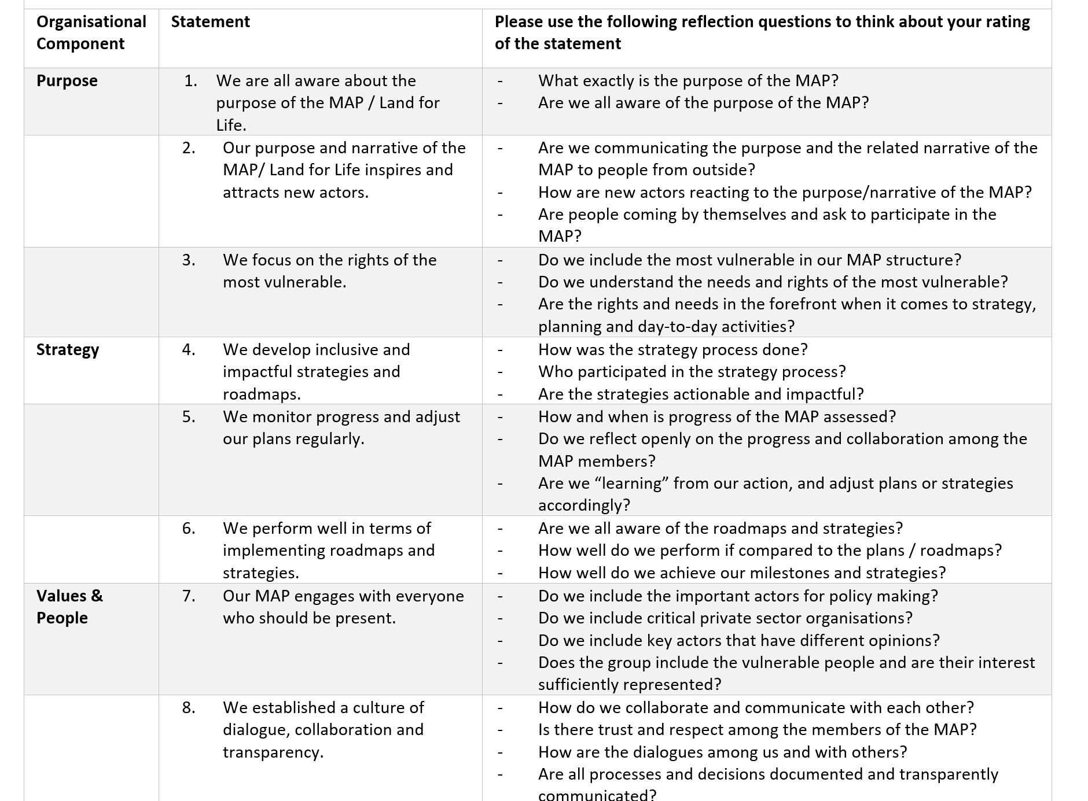
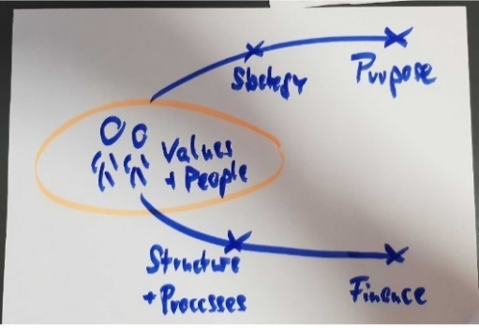
Maturity
Assessment

Slide 20
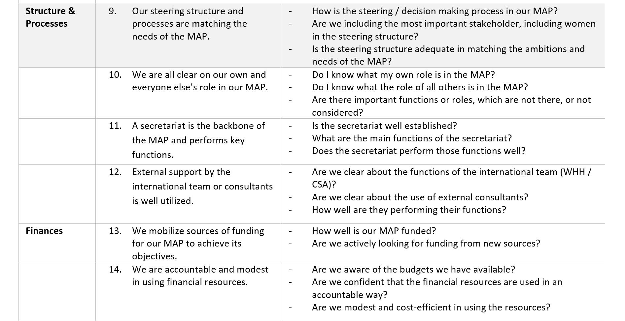
Maturity
Assessment
Supported through Land for Life by Welthungerhilfe and the German Ministry for Economic Collaboration and Development (BMZ).

Slide 21
1.5. Performance Check of the team –
looking at the efficiency and effectiveness
Step 1: Preparation
The secretariat fills templates to understand the outputs of LfL since Sep 2020 along three key processes
Dialogue and capacity building process, incl stakeholder dialogues, thematic working group meetings, workshops, lobby meetings …
Communication process incl. website, articles, policy papers, strategy docs, also media coverage
Steering and Management Process incl strategy meetings, board meetings etc.
Step 2: Workshop
During the workshop, we will have an in-detail discussion on the statement 11 and the associated questions:
Statement 11: A secretariat is the backbone of the MAP and performs key functions.
- Is the secretariat well established?
- What are the main functions of the secretariat?
- Does the secretariat perform those functions well?
Step 2: Interviews
The insights are triangulated in interviews and the insights are amended accordingly

Slide 22
Workshop
 | JOUR 1: Evaluation | JOUR 2: Plannification
SESSION 1 9:00 – 10:00 (1h) | Présentation (20’) Introduction à la méthodologie de l’évaluation (20’) Revue du document de stratégie Présentation de la stratégie de la PMAF (20’) | Présentation de la journée (10’) Priorisation de la PMAF sur la base des résultats de la maturité (50’) Choix des 4 principales priorités
SESSION 2 10:00 – 11:20 (1h20) | Vérification des performances (80’) Evènements de dialogues et leur effectivité et efficacité (30’) Documents de communication et de politique et leur effectivité et efficacité (30’) Leçons apprises (20’) | Théorie du changement (1) (120’) Présentation de la théorie du changement par le Secrétariat (20’) Discussion en plénière ou en groupes (60’)
11:50 – 12:30 (40 min) | Introduction à la récolte des résultats (40’) Définition de résultat (5’) Presentation des résultats majeurs des dernières années sur un calendrier (15’) Choix des résultats pour développer la narration (20’) | Théorie du changement (2) (40’) Finalisation de la théorie du changement en plénière
PAUSE DEJEUNER
SESSION 3 13:30 – 14:30 (1h) 14:30 – 15:30 (1h) | Récolte des résultats (120’) Travail en groups (3): Développer le récit des résultats et identifier les preuves Restitution et discussion | Discussions sur: la finalisation de la mise en oeuvre de la stratégie (30’) les synergies avec les autres acteurs et processus (30’) Engagements personnels
SESSION 4 16:00 – 17:00 (1h) 17:00 – 17:30 (30 min) | Maturité de la plateforme (60’) Réponses aux Déclarations individuellement ou en plénière (30’) Discussion (30’) Cloture et présentation du jour 2 | Evaluation et Cloture

Slide 23
Key informant
interviews
N° | NOM | PRENOM | CONTACTs | Structure/organisation
1 | SILGA | Lucien | 70734522 | FIAN Burkina
2 | KABORE | Daniel | 70719384 | Ex DGFOMR
3 | LOURE | K. François | 70239589 | Ex DGFOMR
4 | TRAORE | Arouna | 70317183 | M.justice
5 | KINDA | Joseph | 75172532 | GRAF
6 | OUEDRAOGO | Ousmane | 78808532 | Konrad Adenaer
7 | NANEMA | Denis | 78126611 | MINEFID/Cadastre
8 | PORGO | Issouf | 70245046 | CPF
9 | OUEDRAOGO | Modeste | 78 30 05 08 | FIAB
10 | Barry | Hassan | 70202843 | RECITAG
Supported through Land for Life by Welthungerhilfe and the German Ministry for Economic Collaboration and Development (BMZ).

Slide 24
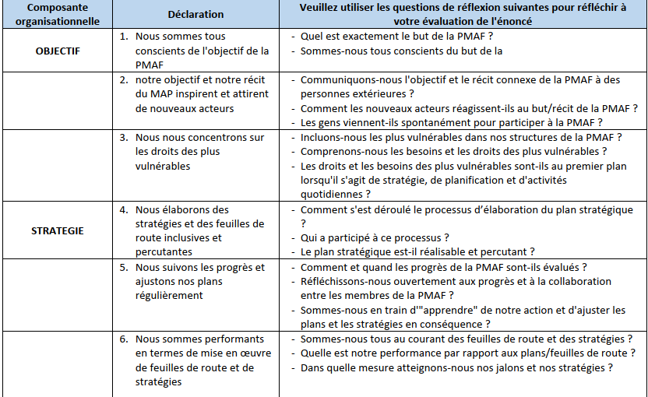
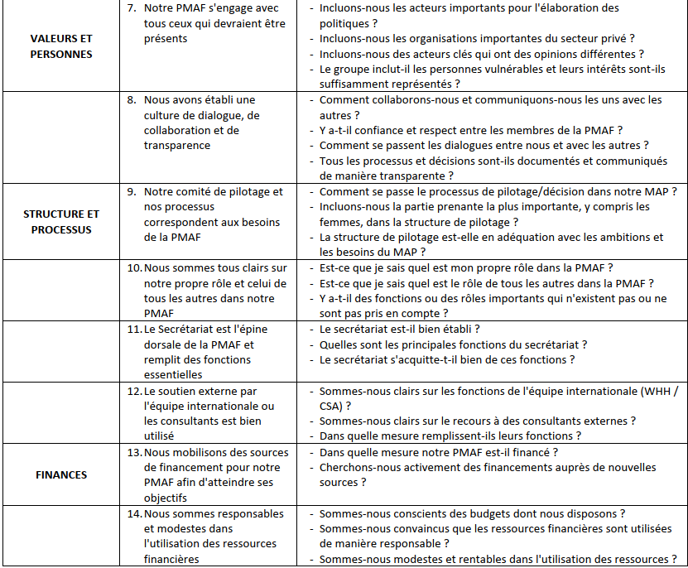
3. Maturity of the PMAF
Each of the statement was discussed in plenary
Burkina Faso

Slide 25
Composante organisationnelle | Déclaration | Veuillez utiliser les questions de réflexion suivantes pour réfléchir à votre évaluation de l'énoncé | Réponses et commentaires
OBJECTIF | 1. Nous sommes tous conscients de l'objectif de la PMAF | Quel est exactement le but de la PMAF ? oui, Sommes-nous tous conscients du but de la pmaf ? oui | Son but c’est de contribuer à la réalisation d’un droit à l’alimentation par la sécurisation foncière des exploitants à petite échelle Oui
 | 2. notre objectif et notre récit du MAP inspirent et attirent de nouveaux acteurs | Communiquons-nous l'objectif et le récit connexe de la PMAF à des personnes extérieures ? Comment les nouveaux acteurs réagissent-ils au but/récit de la PMAF ? Les gens viennent-ils spontanément pour participer à la PMAF ? | Oui, mais pas suffisant Les documents de la PMAF ne sont pas immédiatement partagés avec les nouveaux adhérents ; du coup, tout le monde n’est pas au même niveau d’informations sur la PMAF.
 | 3. Nous nous concentrons sur les droits des plus vulnérables | Incluons-nous les plus vulnérables dans nos structures de la PMAF ? Comprenons-nous les besoins et les droits des plus vulnérables ? Les droits et les besoins des plus vulnérables sont-ils au premier plan lorsqu'il s'agit de stratégie, de planification et d'activités quotidiennes ? | Lorsque nous élaborons les stratégies ou plan d’action, la priorité est donnée aux plus vulnérables
OBJECTIVE
The PMAF mandate and objective is well defined (contribute to tenure security and food security. However, not sufficiently communicated to all members especially the new ones joining the platform.

Slide 26
Composante organisationnelle | Déclaration | Veuillez utiliser les questions de réflexion suivantes pour réfléchir à votre évaluation de l'énoncé | Réponses et commentaires
STRATEGIE | 4. Nous élaborons des stratégies et des feuilles de route inclusives et percutantes | Comment s'est déroulé le processus d’élaboration du plan stratégique ? Qui a participé à ce processus ? Le plan stratégique est-il réalisable et percutant ? | Il est en cours d’élaboration
 | 5. Nous suivons les progrès et ajustons nos plans régulièrement | Comment et quand les progrès de la PMAF sont-ils évalués ? Réfléchissons-nous ouvertement aux progrès et à la collaboration entre les membres de la PMAF ? Sommes-nous en train d'"apprendre" de notre action et d'ajuster les plans et les stratégies en conséquence ? | Une évaluation a été faite en 2020
 | 6. Nous sommes performants en termes de mise en œuvre de feuilles de route et de stratégies | Sommes-nous tous au courant des feuilles de route et des stratégies ? Quelle est notre performance par rapport aux plans/feuilles de route ? Dans quelle mesure atteignons-nous nos jalons et nos stratégies ? | Non. Les nouveaux ne sont pas suffisamment mis à jour
STRATEGY
The new strategy document is under development. ToC already finalized. Assessment of the implementation and results is made regularly through Board meetings. Few delay noted in the implementation.

Slide 27
Composante organisationnelle | Déclaration | Veuillez utiliser les questions de réflexion suivantes pour réfléchir à votre évaluation de l'énoncé | Réponses et commentaires
VALEURS ET PERSONNES | 7. Notre PMAF s'engage avec tous ceux qui devraient être présents | Incluons-nous les acteurs importants pour l'élaboration des politiques ? Incluons-nous les organisations importantes du secteur privé ? Incluons-nous des acteurs clés qui ont des opinions différentes ? Le groupe inclut-il les personnes vulnérables et leurs intérêts sont-ils suffisamment représentés ? | Oui
 | 8. Nous avons établi une culture de dialogue, de collaboration et de transparence | Comment collaborons-nous et communiquons-nous les uns avec les autres ? Y a-t-il confiance et respect entre les membres de la PMAF ? Comment se passent les dialogues entre nous et avec les autres ? Tous les processus et décisions sont-ils documentés et communiqués de manière transparente ? | Il y a les réunions, les mails, whatsapp,…. Les différentes instances (CA et AG) sont informées
VALUES AND PEOPLE
The PMAF is sufficiently inclusive of different constituencies (government, private sector, CBOs, farmers’ org., CSOs, academia, etc. ) who communicate through different means and meet regularly . Information however needs to be improved.

Slide 28
Composante organisationnelle | Déclaration | Veuillez utiliser les questions de réflexion suivantes pour réfléchir à votre évaluation de l'énoncé | Réponses et commentaires
STRUCTURE ET PROCESSUS | 9. Notre comité de pilotage et nos processus correspondent aux besoins de la PMAF | Comment se passe le processus de pilotage/décision dans notre MAP ? Incluons-nous la partie prenante la plus importante, y compris les femmes, dans la structure de pilotage ? La structure de pilotage est-elle en adéquation avec les ambitions et les besoins du MAP ? | C’est l’assemblée générale qui donne valide les décisions
 | 10. Nous sommes tous clairs sur notre propre rôle et celui de tous les autres dans notre PMAF | Est-ce que je sais quel est mon propre rôle dans la PMAF ? Est-ce que je sais quel est le rôle de tous les autres dans la PMAF ? Y a-t-il des fonctions ou des rôles importants qui n'existent pas ou ne sont pas pris en compte ? | Non, tous le monde n’est pas conscient de son rôle ou de celui des autres
 | 11. Le Secrétariat est l'épine dorsale de la PMAF et remplit des fonctions essentielles | Le secrétariat est-il bien établi ? Quelles sont les principales fonctions du secrétariat ? Le secrétariat s'acquitte-t-il bien de ces fonctions ? | Oui Le secrétariat met en œuvre les activités
 | 12. Le soutien externe par l'équipe internationale ou les consultants est bien utilisé | Sommes-nous clairs sur les fonctions de l'équipe internationale (WHH / CSA) ? Sommes-nous clairs sur le recours à des consultants externes ? Dans quelle mesure remplissent-ils leurs fonctions ? | non
STRUTURES AND PROCESSES
With the institutionalization, the PMAF structures with their assigned roles and responsibilities are more and less clear. The Secretariat is very active and leads the overall implementation of the action plan under the scrutiny of the board and the host. But they lack clarity on the support they can request and benefit from the international support team.

Slide 29
Composante organisationnelle | Déclaration | Veuillez utiliser les questions de réflexion suivantes pour réfléchir à votre évaluation de l'énoncé | Réponses et commentaires
FINANCES | 13. Nous mobilisons des sources de financement pour notre PMAF afin d'atteindre ses objectifs | Dans quelle mesure notre PMAF est-il financé ? Cherchons-nous activement des financements auprès de nouvelles sources ? | Financement WHH, ILC Les membres aussi contribuent quand il le faut (ONF, GIZ pour les JNAF)
 | 14. Nous sommes responsables et modestes dans l'utilisation des ressources financières | Sommes-nous conscients des budgets dont nous disposons ? Sommes-nous convaincus que les ressources financières sont utilisées de manière responsable ? Sommes-nous modestes et rentables dans l'utilisation des ressources ? | Pas vraiment. Tous les membres n’ont pas une idée des ressources de la PMAF
FINANCES
The PMAF manages to get additional funding from ILC in support of it’s roadmap implementation. But with the instutionalization and decentralization, the running costs will increase with no clear perspective on how these will be covered beyond the WHH modest contribution.

Slide 30
OVERALL RECOMMENDATIONS
FOLLOWING THE MATURITY ASSESSMENT
With the formalization, it is necessary to check the legislation on associations to comply with them
The formalization of the PMAF creates addition and unexpected challenges. Indeed it could lead to additional costs, administrative formalities, …. It will therefore be necessary to anticipate probable situations, review the statutes and regulations to better frame things.
Work to ensure that all members are fully aware of the objectives and vision of the PMAF. Keep new members update.
Remember the PMAF key words: food security, land rights, smallholders
Map the most important world days to participate (food, environment, land, rural women,…..)
Formalize membership. Elaborate for example a form which will be signed by all the members.
Work to retain members, create sympathy, and attract new membership.
Map members' websites and facebook pages and contribute to their visibility.
Ensure that all members are always informed of the activities of the platform (inclusion, participation, consultation, sharing)
Work to ensure that all members are imbued with the PMAF logo and include it in their activities.
The members must accompany the secretariat, follow the activities and challenge when necessary. Determine a fixed period to Evaluate the secretariat.
The secretariat must work for the members. Please share opportunities fairly among members.
Reward members (create the spirit of competition)

Slide 31
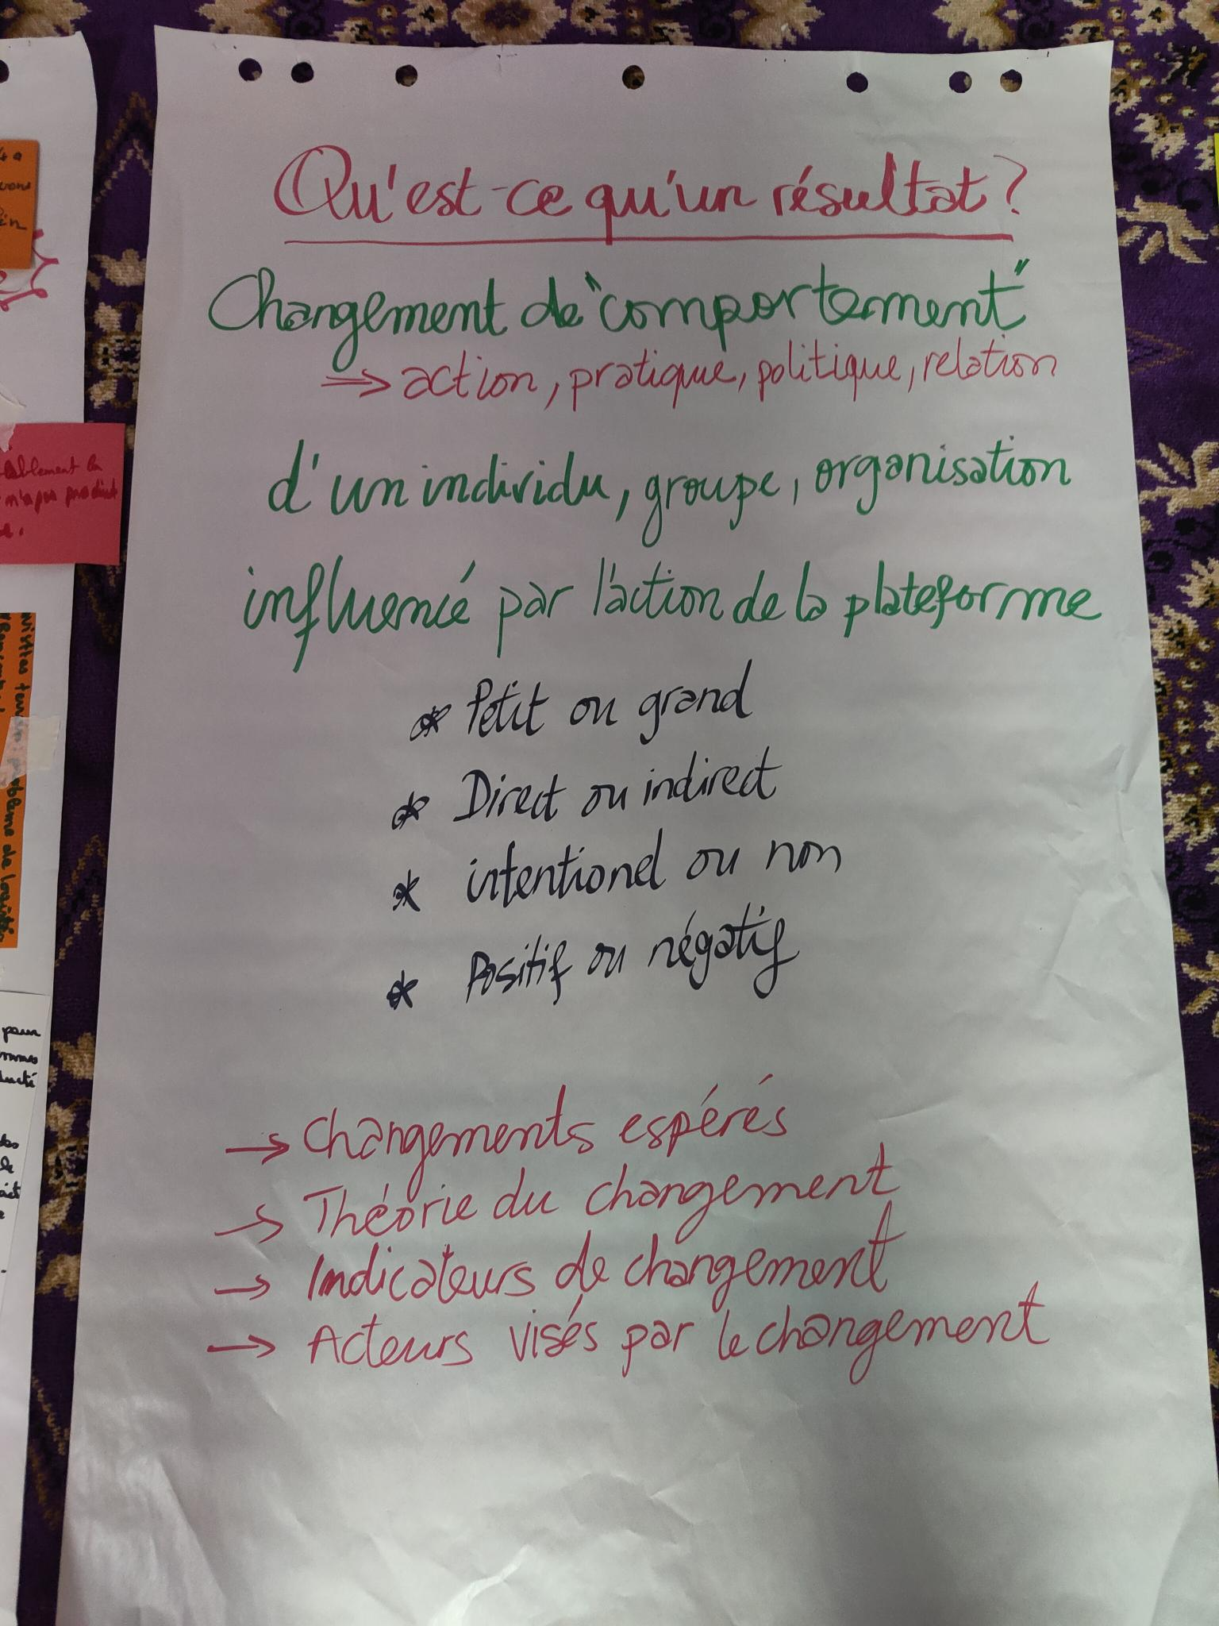
4. Outcomes registered
Burkina Faso

Slide 32
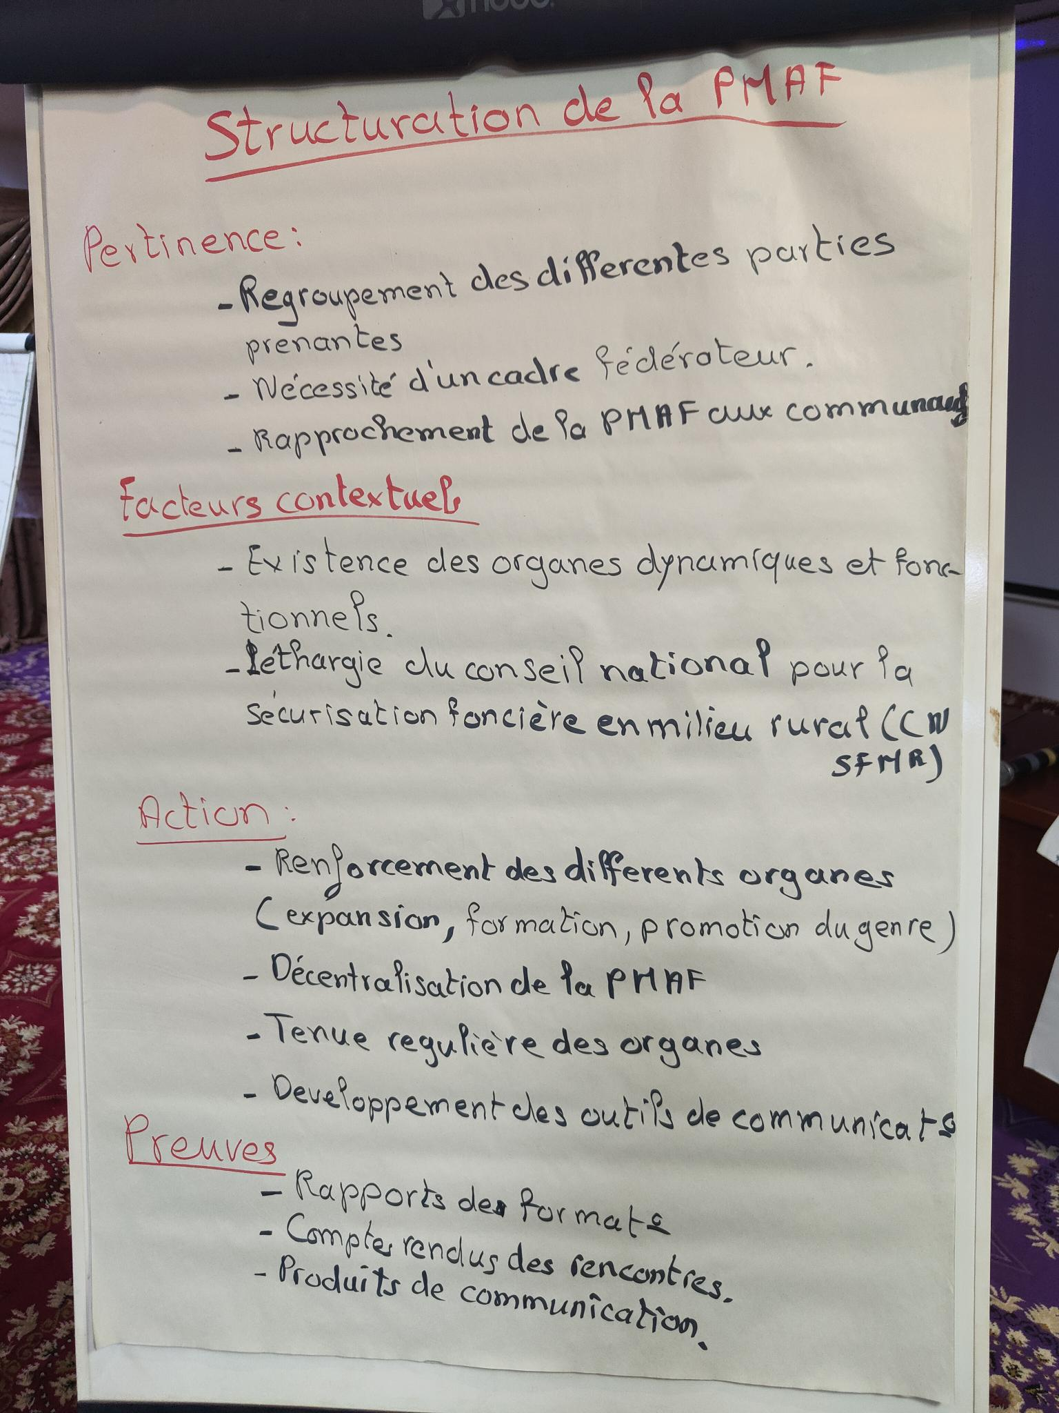
Outcome 1: National level | STRUCTURATION OF THE PMAF (Dialogue platform)
Significance: | Bringing together different stakeholders Need to have a common framework Bringing dialogue platform closer to the communities
How did LfL contribute | Strenghtening of various PMAF organs (expansion, capacity building, gender justice promotion, etc.) Decentralisation of the PMAF Regular meetings of PMAF organs Development of communication tools
Context: | Existing dynamic institutions/organizations Non functioning of the National Council for tenure security in the rural areas
Evidence | Training reports Meetings reports Communication products
Notes

Slide 33
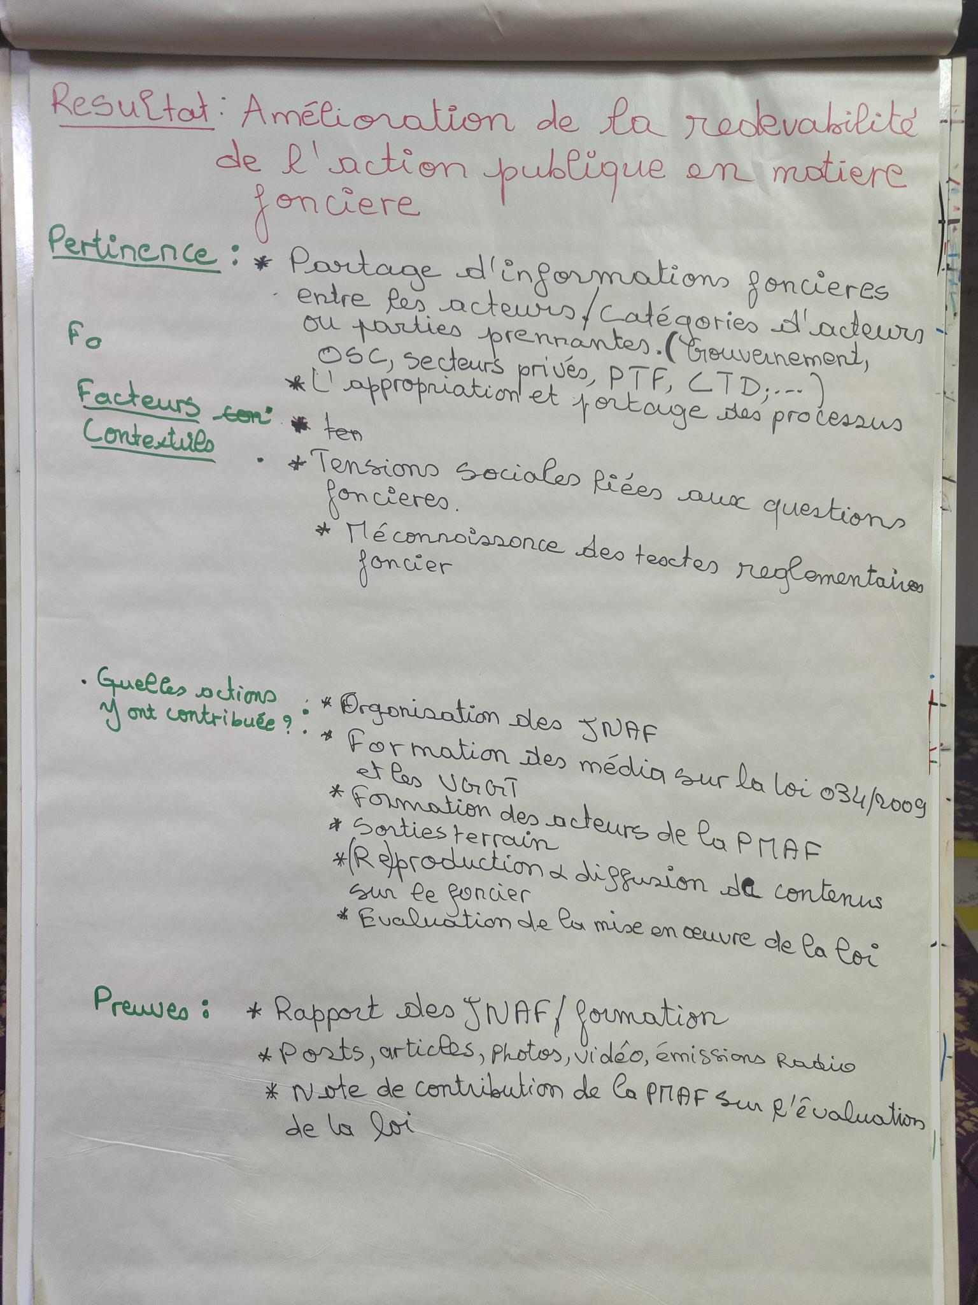
Outcome 2: National Level | Improvement of the accountability in the land sector
Significance: | Need to share land related information among different stakeholders Ownership and sharing of different processes
How did LfL contribute | Organization of JNAF Training of media on Law 034/2009 and VGGTs Field visits (re)production and dissemination of land related info/content Evaluation of the implementation of the land legislation
Context: | Social tensions linked to land. Illiteracy on land legislation.
Evidence | JNAF report Training reports Posts, articles, photos, videos, radio airings Contribution Note on the assessment of the land law
Notes

Slide 34
Outcome 3: National Level | Contribution to the implementation of the Law 034/2009
Significance: | Need to assess the progress on the implementation of the law, identify issues and formulate recommendations
How did LfL contribute | Preparation and submission of a Contribution Note Field visits
Context: | Existing provision in the law of a participatory evaluation every 5 years The government quick started the evaluation process Presence of entry points within the government and the evaluation committee
Evidence | Contribution Note Field visits reports Report of the submission meeting Posts and articles Law Evaluation report by the committee
Notes

Slide 35
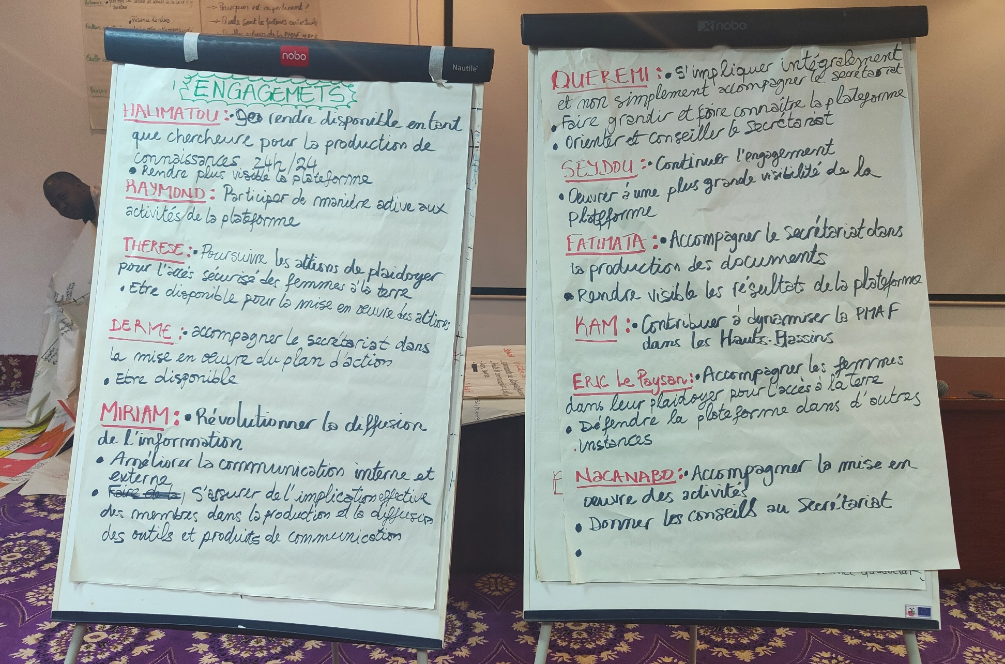
PERSONAL COMMITMENTS
BY THE PARTICIPANTS

Slide 36
